Slide 1

ATM Dispense Forecasting
Model Performance & Evaluation
Optimizing Cash Management with XGBoost
PRESENTER: Jahnvi Sikligar

Slide 2

Model Training and Evaluation Overview
Model Architecture
Model: XGBoost Regressor
Key Parameters: n_estimators=300, learning_rate=0.05, max_depth=6
Justification: Superior handling of tabular data and complex non-linear relationships.
Validation Strategy
Method: Time-based split (cutoff: 2023-02-15)
Rationale: Mimics real-world forecasting by testing on unseen future data.
Performance Metrics
MAE (Mean Absolute Error): Measures average error magnitude; robust to outliers; highly interpretable.
RMSE (Root Mean Squared Error): Penalizes larger errors; critical when significant deviations must be avoided.

Slide 3


Model Performance - Baseline v/s XGBoost
Baseline Method
XGBoost Model
MAE: 140623.42
RMSE: 191705.33
MAE: 1018.13
RMSE: 1306.61
Takeaway: The XGBoost model demonstrates a significant performance improvement over the baseline model across both MAE and RMSE. The substantial reduction in error metrics highlights the XGBoost model's superior ability to capture complex patterns and provide highly accurate predictions for ATM dispense amounts.

Slide 4

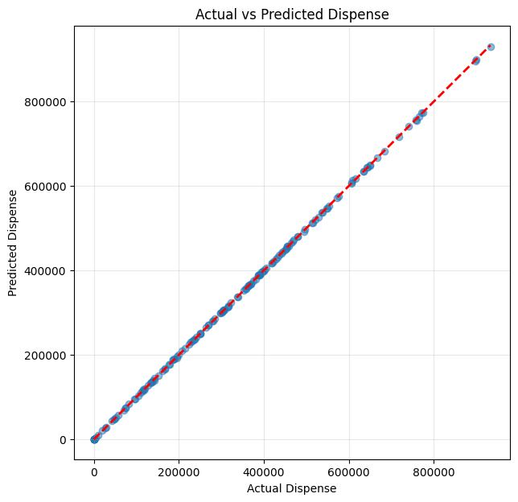
Overall Actual v/s Predicted Dispense
Key Observations
The Actual (blue line) and Predicted (orange line) dispense amounts show a remarkably close alignment over the entire forecasting period.
This strong visual correlation indicates the model's excellent ability to capture the general trend and daily fluctuations in ATM cash dispense.
The consistent overlap between the actual and predicted lines reinforces the quantitative metrics (MAE: 1,018.13, RMSE: 1,306.61), demonstrating the model's high accuracy in real-world scenarios.
This plot, generated visually confirms the effectiveness of the XGBoost Regressor in providing reliable dispense forecasts.

Slide 5
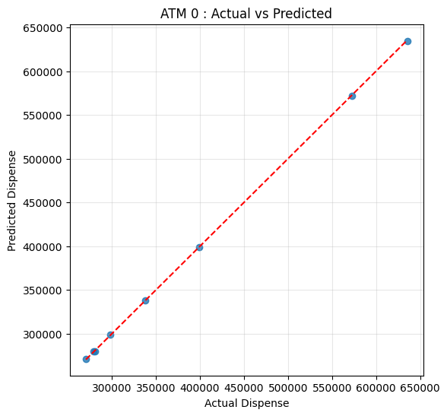
ATM-Specific Actual vs Predicted Dispense
OBSERVATION
The blue line (Actual) and orange line (Predicted) for the chosen ATM show a remarkably close fit, even capturing daily fluctuations.
This indicates the model's strong capability to learn and predict the unique dispense patterns of individual ATMs, rather than just overall trends.
The visual alignment provides compelling evidence that the model is effective at a micro-level, which is crucial for precise cash management.

Slide 6
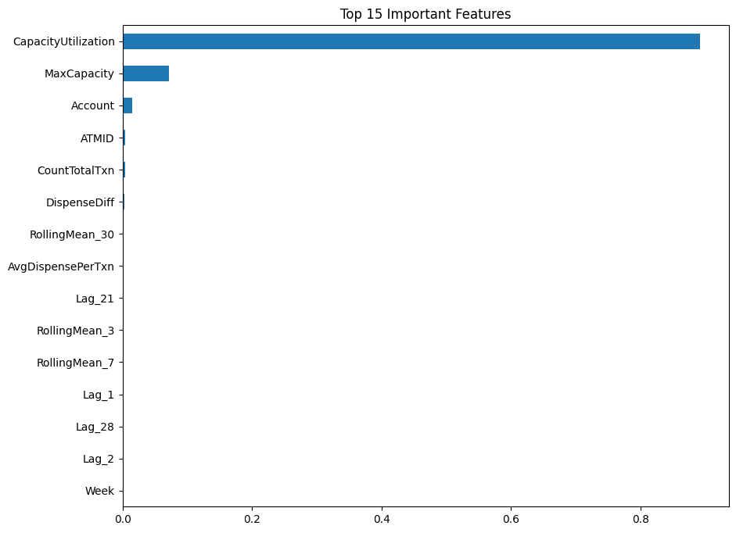
Feature Importance
Key Drivers of ATM Dispense Forecasts
CapacityUtilization: Ratio of Dispense to MaxCapacity; signals demand relative to replenishment needs.
MaxCapacity: Defines operational limits and potential dispense ceiling.
Account & ATMID: Incorporates context (location, demographics, bank policies, traffic).
CountTotalTxn: Key volume metric correlating with total cash dispensed.
Lagged Dispense (Lag_1, 7, 21): Captures daily autocorrelation and multi-weekly seasonality.
Impact: These features optimize cash management, reducing 'Cash Out' risks and minimizing idle cash penalties.

Slide 7
ATM Dispense Forecasting: Model Performance & Evaluation
Model Effectiveness: The XGBoost Regressor significantly outperforms the Lag_1 baseline (MAE ~$1,018 vs. ~$140,623). By utilizing drivers such as CapacityUtilization, MaxCapacity, ATMID, and transaction data, it enables precise, ATM-level cash management.
Operational Recommendations: Integrate forecasts into daily workflows, optimize replenishment to minimize ‘Cash Out’ and idle cash, monitor key performance drivers, retrain models regularly, and apply location-specific strategies.
Key Assumptions: Success assumes data integrity, pattern persistence, reliable future feature availability, operational stability, and the potential to enhance the model by capturing unmodeled external factors.
"The proposed XGBoost forecasting framework demonstrates strong predictive capability and provides a practical, scalable solution for improving ATM cash management and supporting operational decision-making."

